Slide 1
Learning from observations
Inductive Learning - learning from examples
  Machine Learning
Notes:
ICS611-Foundations of A.I
Part7.1-Learning

Slide 2
Learning & Adaptation
”Modification of a behavioral tendency by expertise.”
(Webster 1984)
”A learning machine, broadly defined is any device whose
actions are influenced by past experiences.” (Nilsson 1965)
”Any change in a system that allows it to perform better
the second time on repetition of the same task or on another
task drawn from the same population.” (Simon 1983)
”An improvement in information processing ability that results
from information processing activity.” (Tanimoto 1990)

Slide 3
Machine Learning
  Machine learning involves automatic procedures that learn a task from a series of examples
  Most convenient source of examples is data

Slide 4
Learning
Definition:
A computer program is said to learn from experience E with respect to some class of tasks T and performance measure P, if its performance at tasks in T, as measured by P, improves with experience.

Slide 5
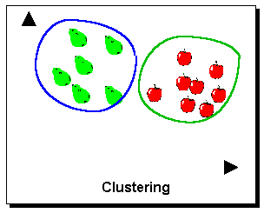
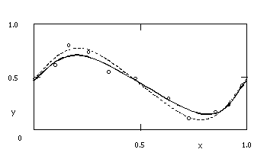
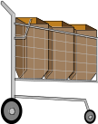


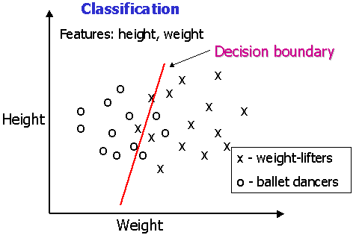






Machine Learning Models
Classification
Regression
Clustering
Time series analysis
Association Analysis
Sequence Discovery
….

Slide 6
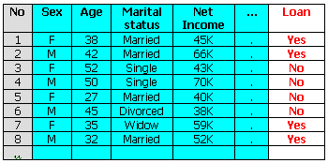
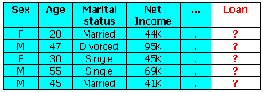
Classification example
New data
Train set
Test set
Model
Loan
Yes/No
Learning system

Slide 7
Machine Learning Methods
Artificial Neural Networks
Decision Trees
Instance Based Methods (CBR, k-NN)
Bayesian Networks
Evolutionary Strategies
Support Vector Machines
..

Slide 8
Classification example
Features: height, weight
x
x
o
x
o
x
o
x
x
Height
o
o
o
x
x
o
x
o
x
o
o
x
x
o
o
x
x - weight-lifters
o - ballet dancers
x
Weight

Slide 9
Classification example - Simple Model
Features: height, weight
Decision boundary
x
x
o
x
o
x
o
x
x
Height
o
o
o
x
x
o
x
o
x
o
o
x
x
o
o
x
x - weight-lifters
o - ballet dancers
x
Weight

Slide 10
Classification example - Complex model
Features: height, weight
Complex Decision boundary
x
x
o
x
o
x
o
x
x
Height
o
o
o
x
x
o
x
o
x
o
o
x
x
o
o
x
x - weight-lifters
o - ballet dancers
x
Weight
Note: A simple decision boundary is better than a complex one - It GENERALIZES better.

Slide 11
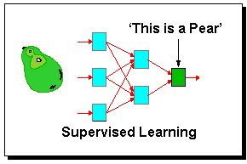
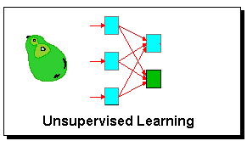
Learning Paradigms
Supervised learning - with teacher
    inputs and correct outputs are provided by the teacher
Reinforced learning - with reward or punishment
    an action is evaluated
Unsupervised learning - with no teacher
    no hint about correct output is given

